Slide 1

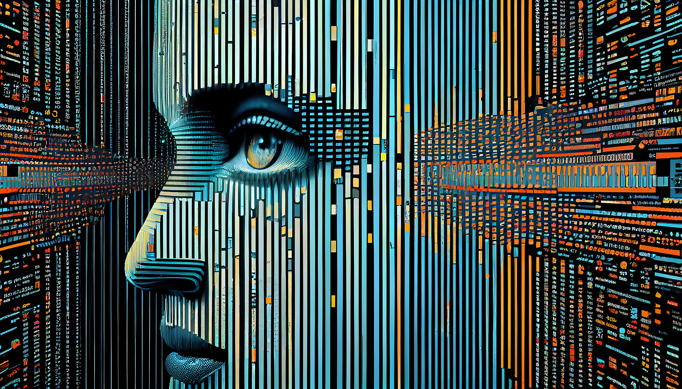
Introduction To
Digital Image Fundamentals
Seminar Presentation

